Slide 1
Course Code: CSC211A Course Title: Formal Languages and Automata Theory
Lecture 33: Variations of Turing Machines -2
Course Leader:
Prakash P
prakashp.cs.et@msruas.ac.in

Slide 2
Session Objectives
At the end of this session, student will be able to
Explain off-line machines
Describe multitape Turing machines
Understand multi-dimensional Turing machines
Explain non-deterministic Turing machines
Describe deterministic Turing machines

Slide 3
Session Topics
Off-Line Machines
Multitape Turing Machines
Multi-Dimensional Turing Machines
NonDeterministic Turing Machines
Deterministic Turing Machines

Slide 4
Off-Line Machines
Theorem:
Off-line machines have the same power with Standard machines

Slide 5
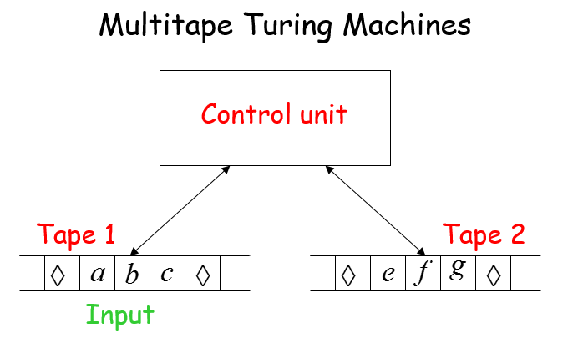
Multitape Turing Machines

Slide 6
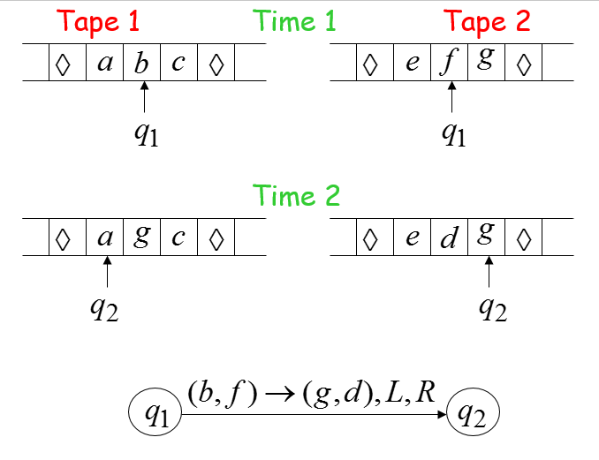
Time 1

Slide 7
Multitape Machines
Multitape machines simulate Standard Machines:
Use just one tape

Slide 8
Multitape Machines
Standard machines simulate Multi-tape machines:
Standard machine:
Use a multi-track tape
A tape of the Multiple tape machine corresponds to a pair of tracks

Slide 9
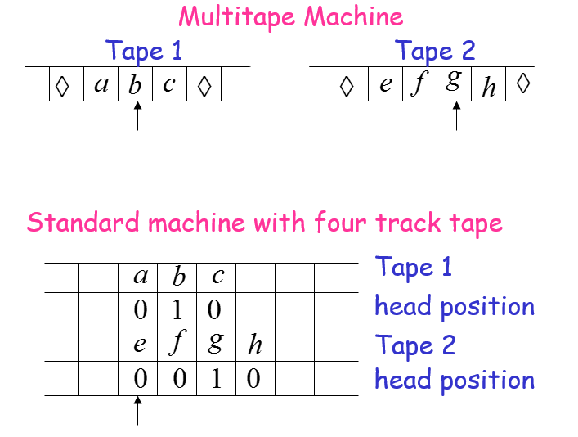
Multitape Machines

Slide 10
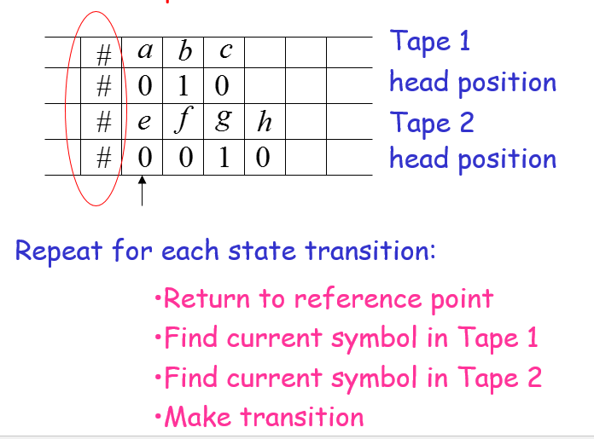
Reference Point

Slide 11
Multitape Machines
Theorem:
Multi-tape machines have the same power with Standard Turing Machines

Slide 12
Multitape Machines
Same power doesn’t imply same speed:
Language
Acceptance Time
Standard machine
Two-tape machine

Slide 13
Multitape Machines
Standard machine:
Go back and forth times
Two-tape machine:
Copy to tape 2
( steps)
Leave on tape 1
( steps)
Compare tape 1 and tape 2
( steps)

Slide 14
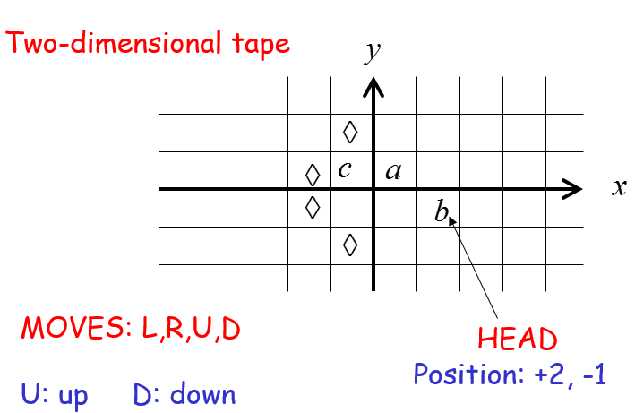
Multi-Dimensional Turing Machines

Slide 15
Multi-Dimensional Turing Machines
Multidimensional machines simulate Standard machines:
Use one dimension

Slide 16
Multi-Dimensional Turing Machines
Standard machines simulate Multidimensional machines:
Standard machine:
Use a two track tape
Store symbols in track 1
Store coordinates in track 2

Slide 17
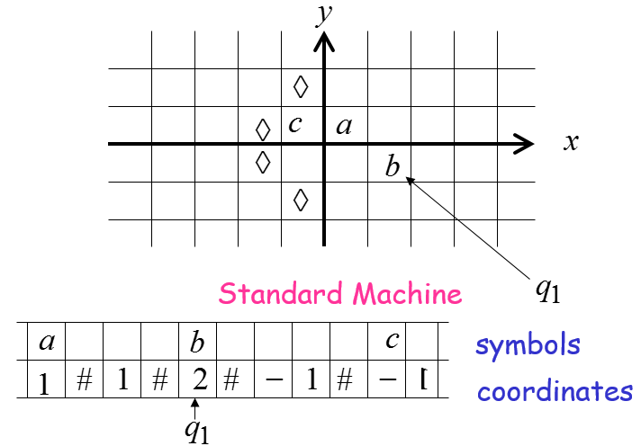
Two-dimensional Machine

Slide 18
Standard Machine
Repeat for each transition
Update current symbol
Compute coordinates of next position
Go to new position

Slide 19
Theorem
Multi Dimensional Machines have the same power with Standard Turing Machines

Slide 20
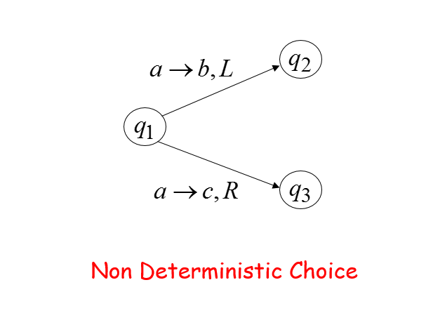
Nondeterministic Turing Machines

Slide 21
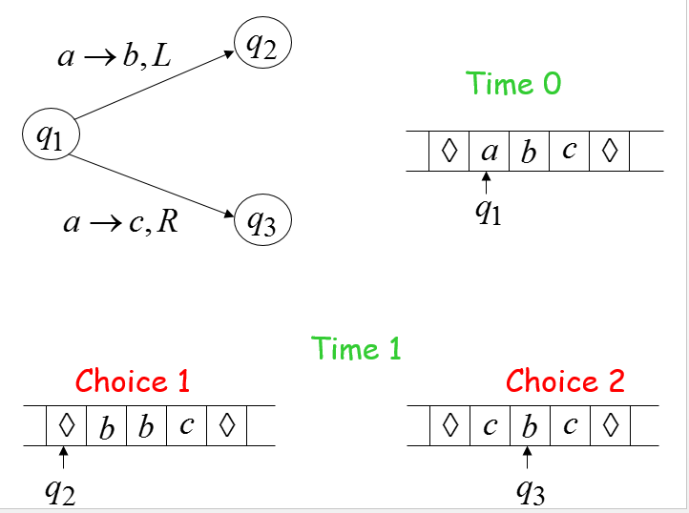
NonDeterministic Turing Machines

Slide 22
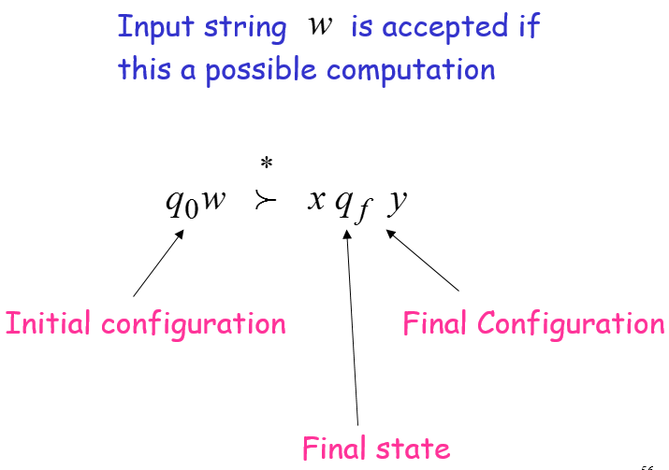
NonDeterministic Turing Machines

Slide 23
NonDeterministic Turing Machines
Non-Deterministic Machines simulate Standard (deterministic) Machines:
Every deterministic machine is also a nondeterministic machine

Slide 24
Deterministic Turing Machines
Deterministic machines simulate Non-Deterministic machines:
Deterministic machine:
Keeps track of all possible computations

Slide 25
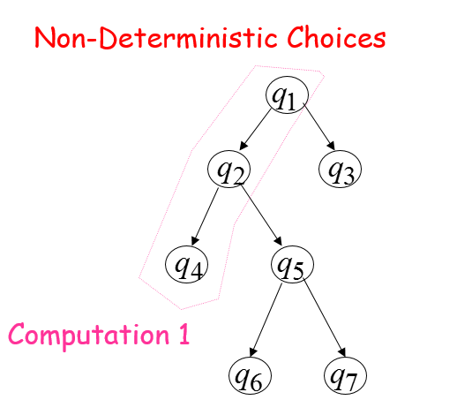
NonDeterministic Turing Machines

Slide 26
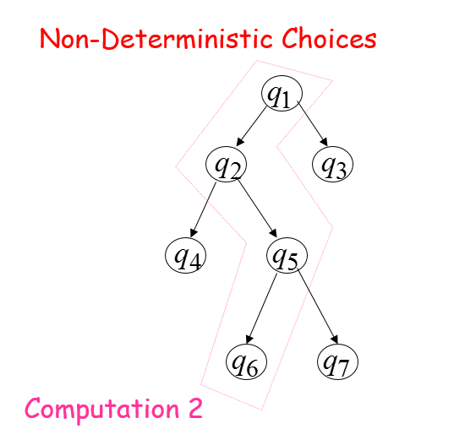
NonDeterministic Turing Machines

Slide 27
Simulation
Deterministic machine:
Keeps track of all possible computations
Stores computations in a two-dimensional tape

Slide 28
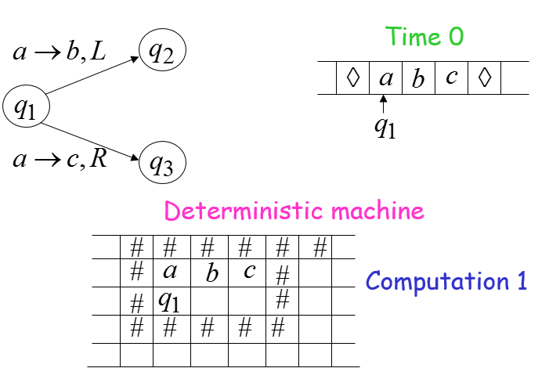
Non-Deterministic Machine

Slide 29
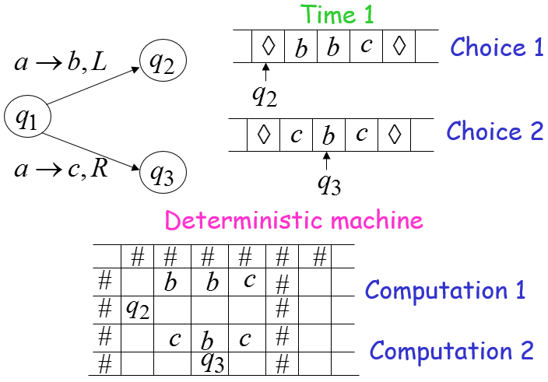
Non-Deterministic Machine

Slide 30
Non-Deterministic Machine
Repeat
Execute a step in each computation
If there are two or more choices in current computation:
1. Replicate configuration
2. Change the state in the replica

Slide 31
Non-Deterministic Machine
Theorem: NonDeterministic Machines have the same power with Deterministic machines

Slide 32
Non-Deterministic Machine
Remark:
The simulation in the Deterministic machine takes time exponential time compared to the NonDeterministic machine

Slide 33
Fundamental Problem
Polynomial Time in NonDeterministic Machine:
NP-Time
Polynomial Time in Deterministic Machine:
P-Time
Fundamental Problem:
P = NP ?

Slide 34
Summary
Multitape machines simulate standard machines
Multi-tape machines have the same power with standard Turing machines
Multidimensional machines simulate standard machines
Non-deterministic machines have the same power with deterministic machines

